Slide 1
Object Oriented

Slide 2
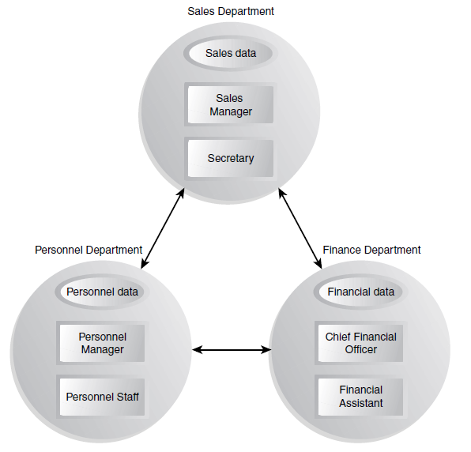
Example

Slide 3
Information Hiding
By Information Hiding we mean “Showing only those details to the outside world which are necessary for the outside world and hiding all other details from the outside world.”
Ali’s name and other personal information is stored in his brain we can’t access this information directly. For getting this information we need to ask Ali about it and it will be up to Ali how much details he would like to share with us.
“Hiding the object details (state and behavior) from the users”
Object oriented model only had objects and their interactions hiding implementation details
We can achieve information hiding using Encapsulation and Abstraction,

Slide 4
Encapsulation
Encapsulation means “we have enclosed all the characteristics of an object in the object itself”
We have seen in previous lecture that object characteristics include data members and behavior of the object in the form of functions.
So we can say that Data and Behavior are tightly coupled inside an object
Consider the same example of object Ali of previous lecture we described it as follows,

Slide 5
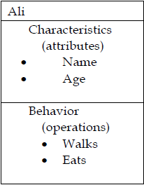
Encapsulation
Now it is up to object Ali whether he wants to share that information with outside world or not.
Same thing stands for its behavior if some other object in real life wants to use his behavior of walking it can not use it without the permission of Ali.
Any other object don’t know about these things unless Ali share this information with that object through an interface,
Same concept also applies to phone which has some data and behavior of showing that data to user we can only access the information stored in the phone if phone interface allow us to do so.

Slide 6
Interface
Interface is a set of functions of an object that he wants to expose to other objects.
Example – Interface of a Car
• Steer Wheels
• Accelerate
• Change Gear
• Apply Brakes
Interface of an object provides us the list of available functions.

Slide 7
Abstraction
“Capture only those details about an object that are relevant to current perspective”
Suppose we want to implement abstraction for the following statement,
“Ali is a PhD student and teaches BS students”
Here object Ali has two perspectives one is his student perspective and second is his teacher perspective.
We can sum up Ali’s attributes as follows,
Name
Age
Student Roll No
Year of Study
CGPA
Employee ID
Designation
Salary

Slide 8
Abstraction
Similarly we can sum up Ali’s behavior as follows,
Study
TakeExam
PlaySports
Eat
DeliverLecture
Walk
As was the case with attributes of object Ali, its behavior can also be divided in Ali’s student perspective as well as Ali’s teacher perspective.
Attributes:
- Name - Employee ID
- Student Roll No - Designation
- Year of Study - Salary
- CGPA - Age

Slide 9
Abstraction
Behaviour:
- Study - DevelopExam
- GiveExam - TakeExam
- PlaySports - Eat
- DeliverLecture - Walk
Teacher’s Perspective
Attributes:
- Name - Employee ID
- Student Roll No - Designation
- Year of Study - Salary
- CGPA - Age
Behaviour:
- Study - DevelopExam
- GiveExam - TakeExam
- PlaySports - Eat
- DeliverLecture - Walk

Slide 10
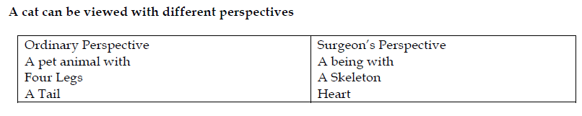
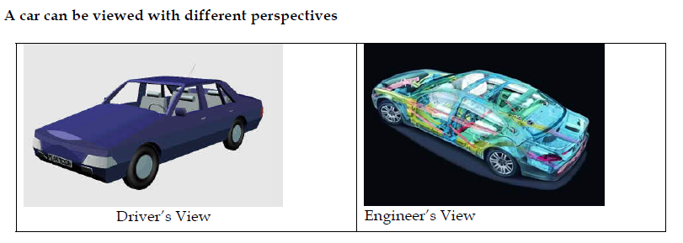
Abstraction

Slide 11
Class
In OOP we create a general sketch for each kind of objects and then we create different instances using this sketch we call this sketch or prototype or map as “class”.
All objects of same kind exhibit identical characteristics (information structure and behavior) however they have data of their own.
Ahsan teaches mathematics
• Aamir teaches computer science
• Atif teaches physics
Each one is a teacher so we say these objects are instances of the Teacher class

Slide 12
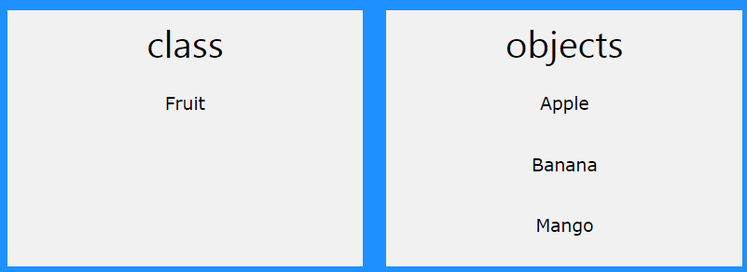
What is a Class
In OOP we say that objects are members of classes.
you can define many objects of the same class.
class serves as a plan, or blueprint. It specifies what data and what functions will be included in objects of that class.

Slide 13
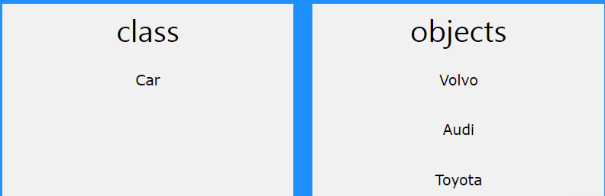
What is a Class
So, a class is a template for objects, and an object is an instance of a class.
When the individual objects are created, they inherit all the variables and functions from the class

Slide 14
What is a Class
Attributes and methods are basically variables and functions that belongs to the class. These are often referred to as "class members“
A class is a user-defined data type that we can use in our program
Private/public

Slide 15
What is a Class

Slide 16
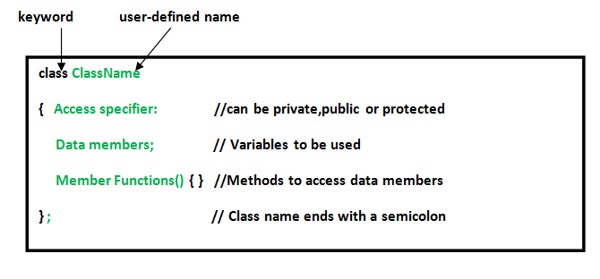
What is a Class
An Object is an instance of a Class. When a class is defined, no memory is allocated but when it is instantiated (i.e. an object is created) memory is allocated.

Slide 17
Create a class
class MyClass { // The class public: // Access specifier int myNum; // Attribute (int variable) string myString; // Attribute (string variable) };
The class keyword is used to create a class called MyClass.
The public keyword is an access specifier, which specifies that members (attributes and methods) of the class are accessible from outside the class. You will learn more about access specifiers later.
Inside the class, there is an integer variable myNum and a string variable myString. When variables are declared within a class, they are called attributes.
At last, end the class definition with a semicolon ;.

Slide 18
Create an Object
#include <iostream>
#include <string>
using namespace std;
class MyClass { // The class
private: // Access specifier
int myNum; // Attribute (int variable)
string myString; // Attribute (string variable)
};
int main() {
MyClass myObj; // Create an object of MyClass
myObj.myNum = 15;
myObj.myString = "Some text";
cout << myObj.myNum << "\n";
cout << myObj.myString;
return 0;
}

Slide 19
state vs behavior
State simply means data or value. E.g dog breed, color
Behavior means action or work or task or operation that the object does e.g bark

Slide 20
Methods/functions
Methods are functions that belongs to the class.
There are two ways to define functions that belongs to a class:
Inside class definition
Outside class definition

Slide 21
Methods/functions
#include <iostream>
using namespace std;
class MyClass { // The class
public: // Access specifier
void myMethod() { // Method/function
cout << "Hello World!";
}
};
int main() {
MyClass myObj; // Create an object of MyClass
myObj.myMethod(); // Call the method
return 0;
}

